Slide 1


The Redesigned Curriculum
parent presentation – opportunity for dialogue

Slide 2
Shape of the presentation
Why the Change?
The Redesigned Curriculum
A shift in perspective

Slide 3

Why the change?
Notes:
Information from: http://engage.gov.bc.ca/yourkidsprogress/en/whychange/

Slide 4

Research on Learning
We are moving forward based on leading practices from around the world and research of how children and teens actually learn, which tells us:
  No two students learn the same way or at the same pace;
  Effective learning is not just memorizing, but being able to apply knowledge in real-world settings; and
  The best outcomes come through approaches that harness students’ own interests and passions.
Notes:
Reason #1 - BC Ministry of Education: “it is what educational research supports” link takes you to parent handout if you want to print for the presentation.
http://engage.gov.bc.ca/yourkidsprogress/en/whychange/

Slide 5
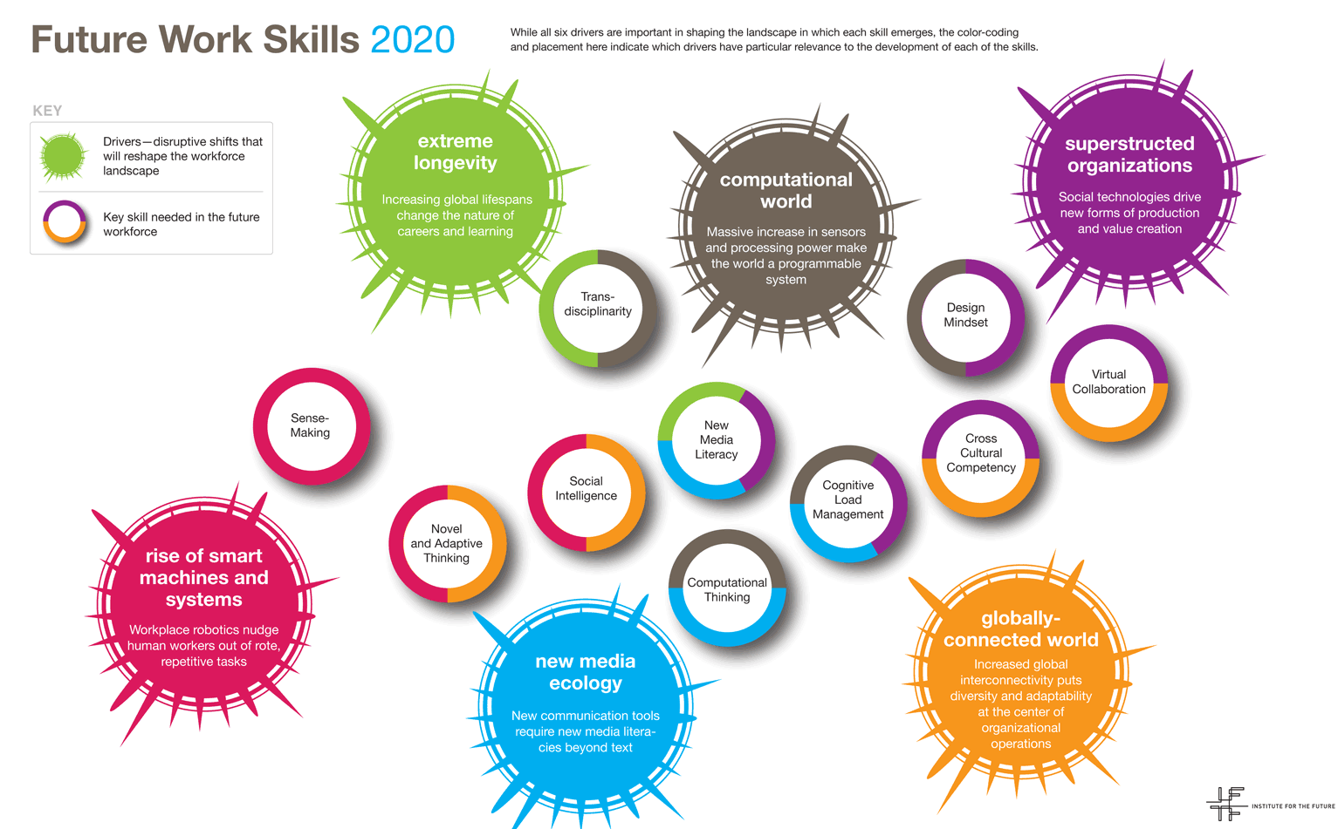
http://www.iftf.org/futureworkskills/
Notes:
Reason #2 - BC Ministry of Education: “prepare students for future undefined occupations with a transferrable skill set”
from University of Phoenix, Institute for the Future http://www.iftf.org/futureworkskills/

Slide 6

Tapping into the passion of youth...
Notes:
Reason #3 - BC Ministry of Education: “tapping into the passion of youth”

Slide 7

First Peoples Principles of Learning
Learning involves patience and time.
Learning requires exploration of one’s identity.
Learning ultimately supports the well-being of the self, the family, the community, the land, the spirits, and the ancestors.
3 of the 9 principles
Notes:
Comment: use the poster
FPPL – were foundational for the curriculum writing teams and here are three of the principles of learning we have chosen to share as these relate to the purpose of our day together….
…we need to give ourselves and our students permission to take time and have patience in this learning journey
…both for students and teachers…understanding each individual and their unique learning styles and abilities
…recognizing that learning and being doesn’t happen in a vacuum and is part of the larger whole
You may want to have the poster available so parents can view all nine principles. Emphasis that these principles are not ‘unique’ and align with educational values shared by many nations.

Slide 8
Educational research
Preparation for future work skills
Embracing the passion of youth
Inclusion of Aboriginal perspectives
Notes:
Information from: http://engage.gov.bc.ca/yourkidsprogress/en/whychange/

Slide 9

Think of your child(ren)…
Who do you want them to be after 13 years in the education system?
Notes:
Comment: We did this with staff and then with PAC, then shared responses which showed we were on the same page.
Consider starting with this an inspiration for WHY?
Table Talk Activity – emphasis on ‘Who do you want them to BE’ and not ‘achieved’ not ‘What do you want them to DO’?
Describe in a single word or short phrase. Write them on a white board or poster paper or sticky notes to reinforce the vision over the course of the presentation…
Then, Response – stand, then ‘popcorn’ – calling out words – presenter to colelct words on a poster paper or whiteboard to refer to for the rest of the presentation.

Slide 10
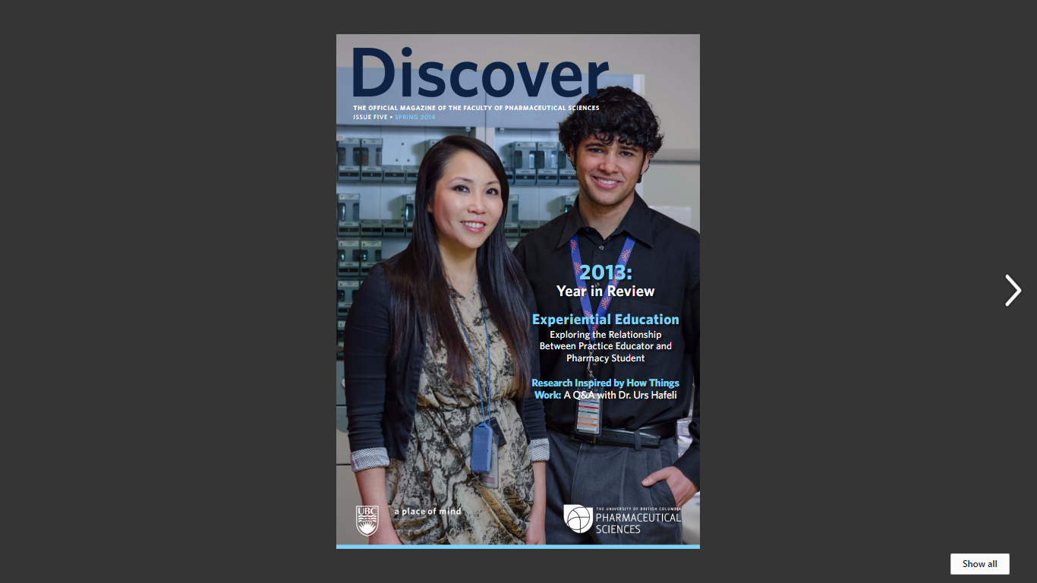
I let students know that in real life, there’s more than one right answer. My job is to teach them how to approach a problem – how to learn, not just what to learn.
~ Mary Ensom
Pharmaceutical Sciences, UBC
Killam Teaching Award Winner
Notes:
Transition to the next section of the presentation - emphasis on LOCAL post secondary perspective that aligns with redesign.

Slide 11

The Redesigned Curriculum

Slide 12
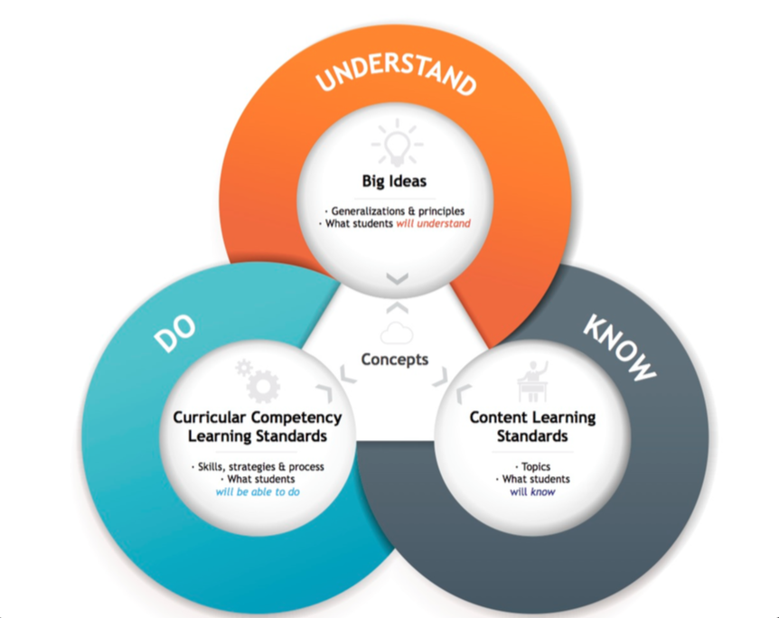
Ministry of Education video on the redesigned curriculum
Notes:
Video on the Big Ideas
Parts students should Understand
Parts students should Do
Parts students should know

Slide 13
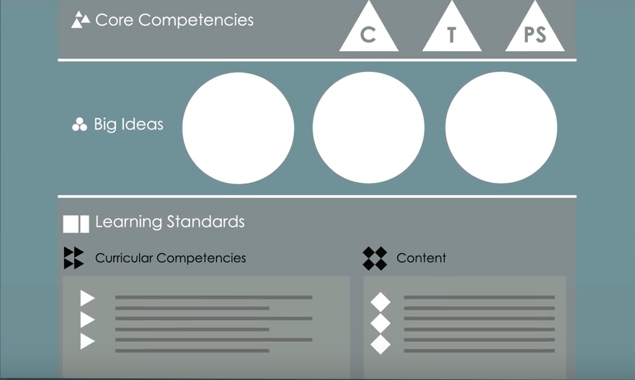
Notes:
This is what teachers see when they look at the new curriculum
Highlight 3 parts:
Core competencies - skills in communicating, thinking, personal and social
Big Ideas - UNDERSTANDING (eg. all matter has mass and takes up space)
Learning Standards - DO and KNOW

Slide 14
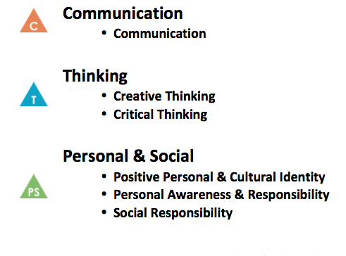
Ministry of Education video
on the Core Competencies
Notes:
There are 6 Core competencies - skills in communicating, thinking, personal and social - that all students K-12 will self-assess at least once a year and provide evidence of their learning in these areas.

Slide 15
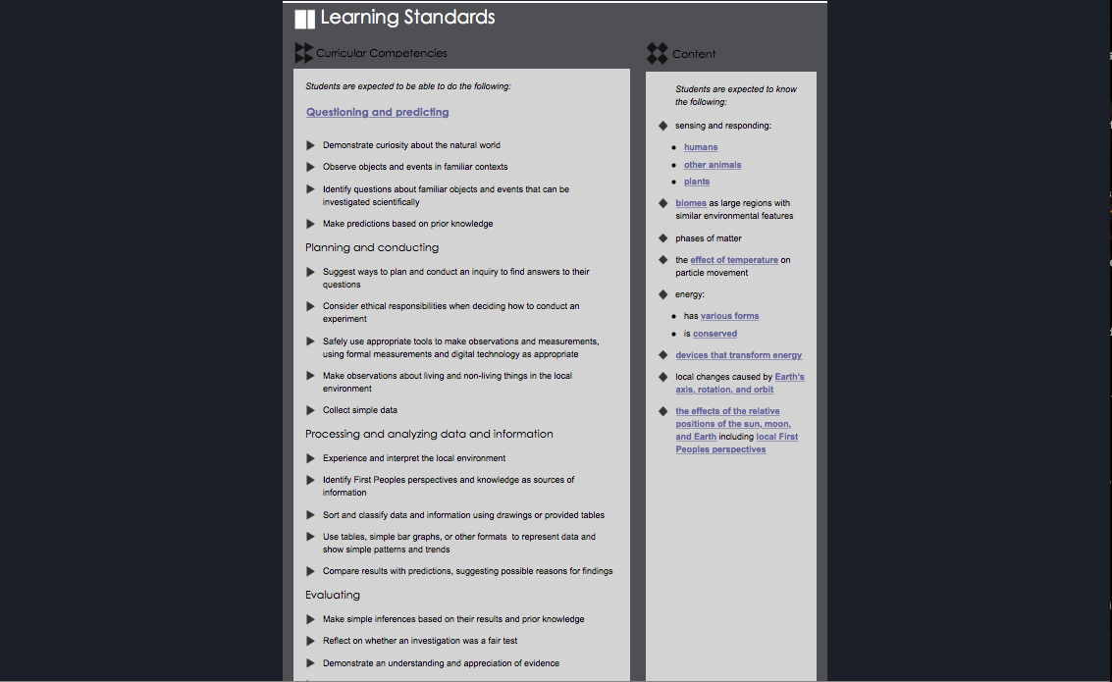
Science 4
Notes:
When a teacher looks at the Learning Standards, this is what they see

Slide 16
Science 4
DO
KNOW
Notes:
Students are being expected to do much more than they are expected to know. Learning is more than just content

Slide 17
Impact of Social Emotional Learning
According to a meta-analysis of 213 studies involving more than 270,000 students, those who participated in evidence-based SEL programs showed an 11 percentile-point gain in academic achievement compared to students who did not participate in SEL programs.
~CASEL - The Collaborative for Academic Social Emotional Learning
Canadian expert working with CASEL - Dr. Kimberly Schonert-Reichl, UBC
Notes:
Connect back to core competencies - what skills kids have
By focusing on SEL, students show academic gains

Slide 18
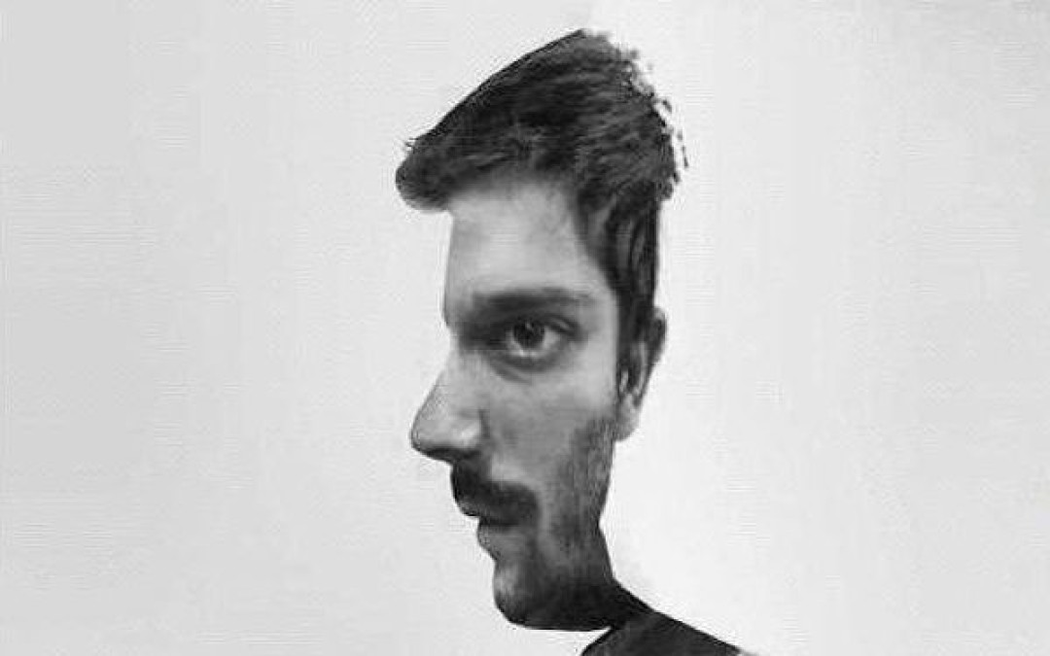
A Shift in Perspective
Notes:
Some of the content may look similar at each grade, but the redesigned curriculum is about more than that.
At it’s core is a greater shift.

Slide 19
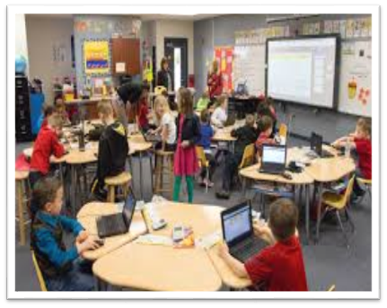

If we are teaching differently, we have to be assessing differently.
Notes:
The learning environment that you and I went through is vastly different from what it is today, but then again, the world we live in is vastly different from what it was 15 to 20 years ago!
Resources
“How has the world changed in the last 20 years?” http://www.unfpa.org/news/how-has-world-changed-last-20-years
“Dialing up 20 years of gadget reviews” http://allthingsd.com/20111102/dialing-up-20-years-of-gadget-reviews/#slideshow-1-20
- And a great image for these changes: http://allthingsd.com/files/2011/11/ptech-tech-timeline.png

Slide 20
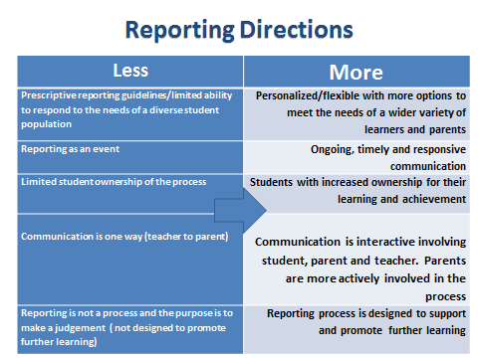
Notes:
Note: This slide is from Ministry of Education, Pat Horstead

Slide 21
A Shift in Perspective
Assessment
The new curriculum and our district’s reporting format:
A conference is the best way to discuss:
  How a child sees himself/herself as a learner (core competencies)
  Not just what students know, but what they can do and what they understand.
  How a child interacts with their learning

Slide 22
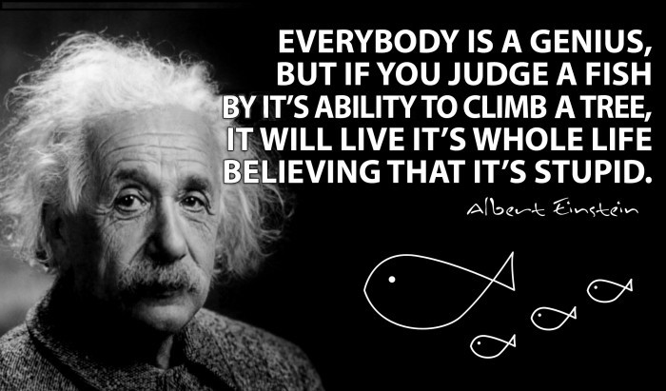

Slide 23



A Shift in Perspective
What you can do...
Support Ask questions Learn
“Alone we can do so little, together we can do so much.”- Helen Keller
Notes:
Support: your child, their learning, the classroom teacher, the school
Ask different questions: instead of asking “how was your day”, try “what did you learn today”, “who did you help today”, “who helped you grow today? How?”
Learn: about the content, the process, and the people sharing the learning journey with your child...Learn with your child, for your child!

Slide 24


A Shift in Perspective
What you can do...
Who your child is/is becoming
Every success BIG and small
Strengths and achievements
Failure as an opportunity to learn and grow
Your child’s teacher, their school, the value of education and the opportunity it provides
Notes:
Academic, social, athletic
In school and outside of school
When in doubt, celebrate any success and who they are!

